Slide 1
Macy’s Tech
Fulfillment enhancements
USING MACHINE LEARNING

Slide 2
Data Analytics at Macy’s Tech
Objective: Turn streaming, operational, and historical data into actionable analysis.
Provide the people, the platform, and the processes through which deep analysis (domain expertise + data science) is performed
Unlock the value of data through data sciences (exploratory, causal, predictive, etc.)
Provide concrete deliverables leading to improved business processes, new or modified associate tools.
Methodologies:
Optimization
Predictive Analytics
Machine Learning

Slide 3
Data Analytics – Macy’s Use Cases

Slide 4
Data Analytics – Macy’s Use Cases

Slide 5
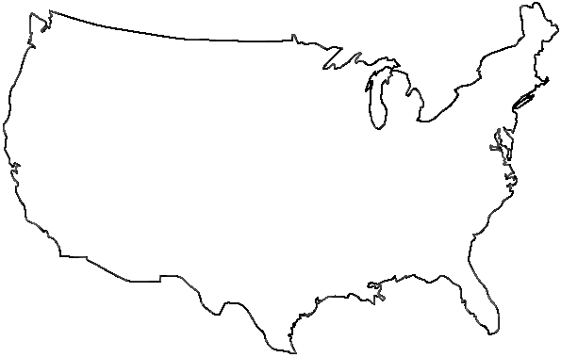


Preferred Fulfillment – Problem
Macys has about 600 stores and distribution centers
When an online order is placed in macys.com, all stores and DCs with available inventory are potential candidates for fulfillment
?

Slide 6
Preferred Fulfillment – Model Approach
Cost minimization taking into account:
Shipping cost
Labor cost (picking and packing)
Combinability of orders with multiple UPCs
Subject to constraints such as:
Store labor capacity
Store shipping capacity
Inventory
Business Rules and Operational goals/constraints taken into account
Warehouse/Store distribution
Preferred locations for certain products

Slide 7
Preferred Fulfillment – Challenges and Solutions
Real time information
Real time interaction with other systems
Size of solution pool: number of locations with availability, number or UPCs in the order, etc.
Solution required in < 1 second
Architecture
Architecture
Heuristic
Algorithms/Architecture

Slide 8

Preferred Fulfillment – Challenges and Solutions
Optimality of preferred fulfillment location(s) is myopic
Assumes item(s) will be fulfilled from assigned location(s)
For >20% of the units assigned for fulfillment there are issues
Item can not be found
Item is damaged
Labor is not available
Machine Learning

Slide 9
Fulfillment System
Store
Shipping
Customer
MCOM Website
Pick
List
Outings

Slide 10
Preferred Fulfillment – Why ML?
Data for unfulfilled/reassigned units was studied
Found several factors that influence the chance of an assignment being “bounced”
Location
Units on-hand
Type of product
Store’s fulfillment success in the last few days
etc.

Slide 11
Machine Learning: Predict Outings
Date
Store 1: 15%
Store 3: 77%
Store 6: 43%
Store 7: 21%
Store 9: 5%
UPC
Store Nbr
Units Req
Order Time
Units in Store

Slide 12
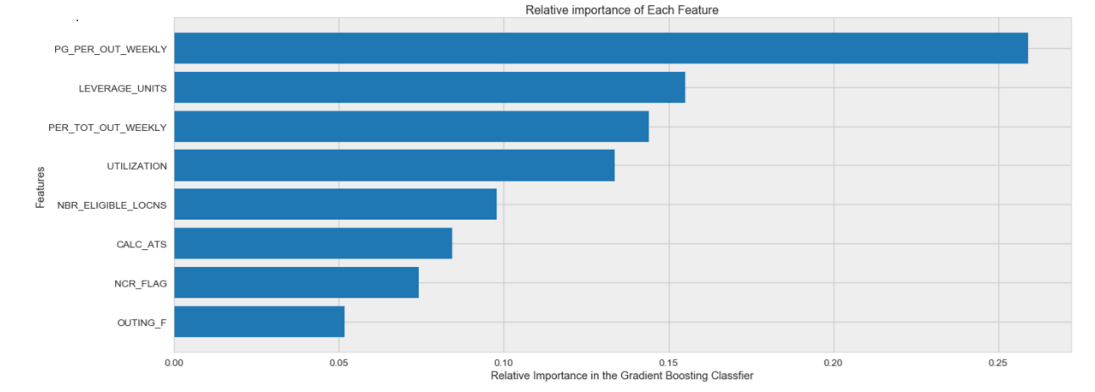
Gradient Boosting – Features

Slide 13
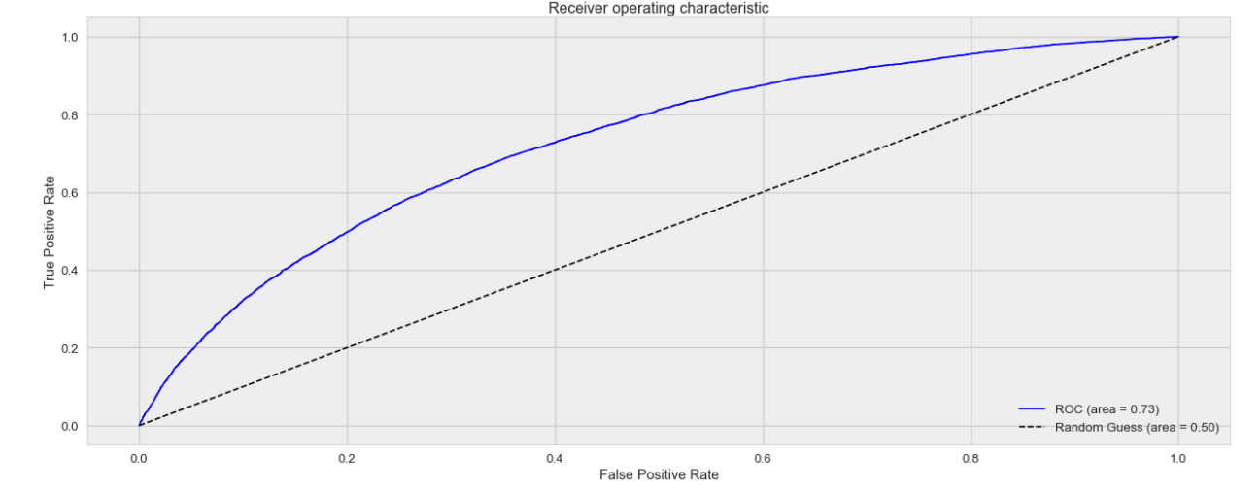
Gradient Boosting – ROC

Slide 14
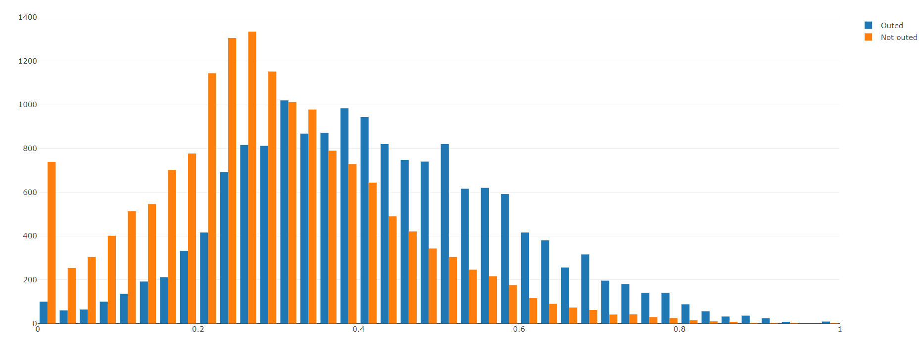
Neural Networks – Outed vs. Not Outed
Observations
Probability

Slide 15
Preferred Fulfillment – ML Enhancement
Consider probability of fulfillment in Cost Function
Use machine learning model to estimate probability
Each possible assignment will be a assigned a probability of fulfillment based on location, units on-hand, type of product, store recent performance, etc.
Cost function will have two components:
(Probability that the item is fulfilled from assigned location) x (Cost of fulfilling the item from assigned location) + (Probability of item bouncing from assigned location) x (Costs for trying to fulfill from first location + Extra costs for shipping, labor, split packages, etc.)
The function gets more complex for orders with several UPCs

Slide 16
Preferred Fulfillment – Desired Results
Increase customer satisfaction
On-time deliveries
Less cancellations
Less split shipments
Improve associate productivity
Associates can spend more time taking care of walk-in customers
Decrease labor and shipping costs
Less expedited shipments
Less split shipments
Less time wasted looking for unavailable items

Slide 17
Preferred Fulfillment – ML Extension
The same model can be used to decide if the item should be available for sale in the website
A cancellation usually occurs if an item has >= 3 bounces
Velocity of the item can be introduced in the model
Base the decision on service level (e.g. < 2% cancellations)
If the probability of the an item bouncing more than 3 times is greater than 2%, then the item should not be made available in the website

Slide 19
Questions?

